Slide 1
R1 arm training
Reinforcement learning for reaching
300,000 CPU training steps
No scripted teacher. No DAgger episodes.
Notes:
The task trains five right-arm joints from rewards. The body and fingers remain fixed. The arm targets the hand-base origin. This presentation covers a new application pipeline using established SAC and HER algorithms. It does not claim a new RL optimizer.
Sources
/Users/cesarpascal/Documents/Training/real_r1_arm_policy/rl_reach/runs/cpu_dense_seed1011/report.json
/Users/cesarpascal/Documents/Training/real_r1_arm_policy/rl_reach/train.py

Slide 2
How the new algorithm learns
Soft Actor-Critic
(SAC)
The policy tries arm motions. It learns which actions receive higher rewards.
Reward
Closer to the target earns a better reward. Abrupt motion and collisions incur penalties.
Hindsight replay
(HER)
A failed attempt can teach a different goal: the position the arm actually reached.
Curriculum
Goals start near home. Two evaluations at or above 80% success with zero collisions unlock a wider range.
The policy uses joint feedback and the target position to command five arm joints at 20 Hz.
2
Notes:
SAC means Soft Actor-Critic, an off-policy continuous-control algorithm. The policy and two critics start from random initialization. HER means Hindsight Experience Replay. Future goal relabeling accounts for about 80% of replay samples. Reward is -1[d > 0.04] - d/0.10 minus action magnitude, action-change, and collision costs. We recompute every HER goal reward consistently. Training performs one gradient update per four interactions. The first sparse-only trial reached 0/50 nearby goals at 25,000 interactions. We preserved that trial and trained the reported policy from scratch with the distance term. All demonstration and DAgger counts remain zero. Goal sampling uses forward kinematics only to select spatial goals, without providing action labels or motion trajectories. The curriculum requires success >=80% and zero detected arm/torso collisions on two consecutive 50-episode evaluations.
Sources
https://arxiv.org/abs/1801.01290
https://arxiv.org/abs/1707.01495
/Users/cesarpascal/Documents/Training/real_r1_arm_policy/rl_reach/train.py

Slide 3
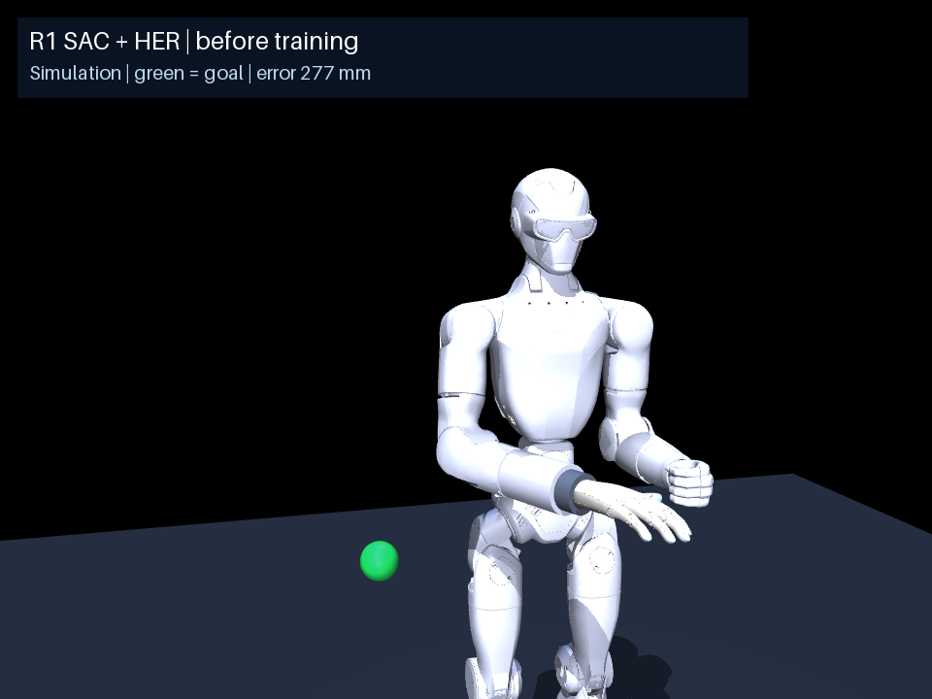
Before training: 0 steps
0 / 100
successes on the widest test set
The random policy moves slowly and misses the green target.
This clip ends 33.9 cm from the target.
3
Notes:
This is the randomly initialized checkpoint, before any optimizer updates. Seed 800000 supplies the same target and reset posture in all three videos. The video is one illustration. The 0/100 result comes from independent matched test seeds 900000–900099 at the widest goal spread.
Sources
/Users/cesarpascal/Documents/Training/real_r1_arm_policy/rl_reach/runs/cpu_dense_seed1011/before_training_seed800000_metrics.json
/Users/cesarpascal/Documents/Training/real_r1_arm_policy/rl_reach/runs/cpu_dense_seed1011/before_training_seed800000_joints.csv
/Users/cesarpascal/Documents/Training/real_r1_arm_policy/rl_reach/runs/cpu_dense_seed1011/report.json

Slide 4
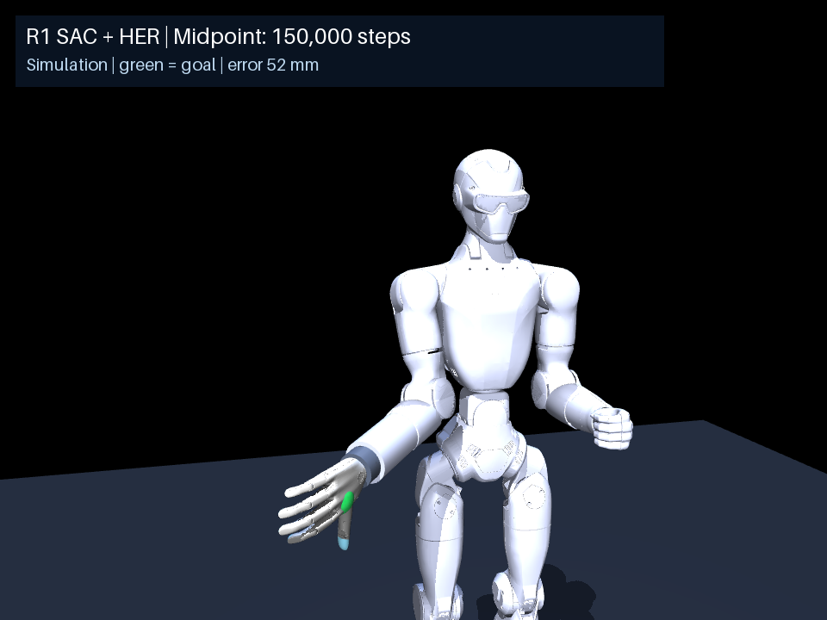
Halfway through training: 150,000 steps
150,000
steps, halfway through the run
The arm moves much closer. This target still misses the 4 cm hold threshold.
4
Notes:
We reproduced the first 150,000 transitions because the original run did not retain a midpoint checkpoint. All six evaluations, including per-episode metrics, match the original history exactly. This is a reproduced midpoint, not an archived original checkpoint. On nearby goals at 150,000 steps, success was 50/50 and mean final error was 1.73 cm. That nearby-goal evaluation differs from the wider comparison target shown here. The displayed seed 800000 clip has no successful half-second dwell and ends at 5.21 cm error. Reproduction source: /Users/cesarpascal/Documents/Training/real_r1_arm_policy/rl_reach/runs/cpu_midpoint_seed1011/reproduction.json
Sources
/Users/cesarpascal/Documents/Training/real_r1_arm_policy/rl_reach/runs/cpu_midpoint_seed1011/checkpoint_150000_steps_seed800000_metrics.json
/Users/cesarpascal/Documents/Training/real_r1_arm_policy/rl_reach/runs/cpu_midpoint_seed1011/checkpoint_150000_steps_seed800000_joints.csv
/Users/cesarpascal/Documents/Training/real_r1_arm_policy/rl_reach/runs/cpu_midpoint_seed1011/report.json

Slide 5
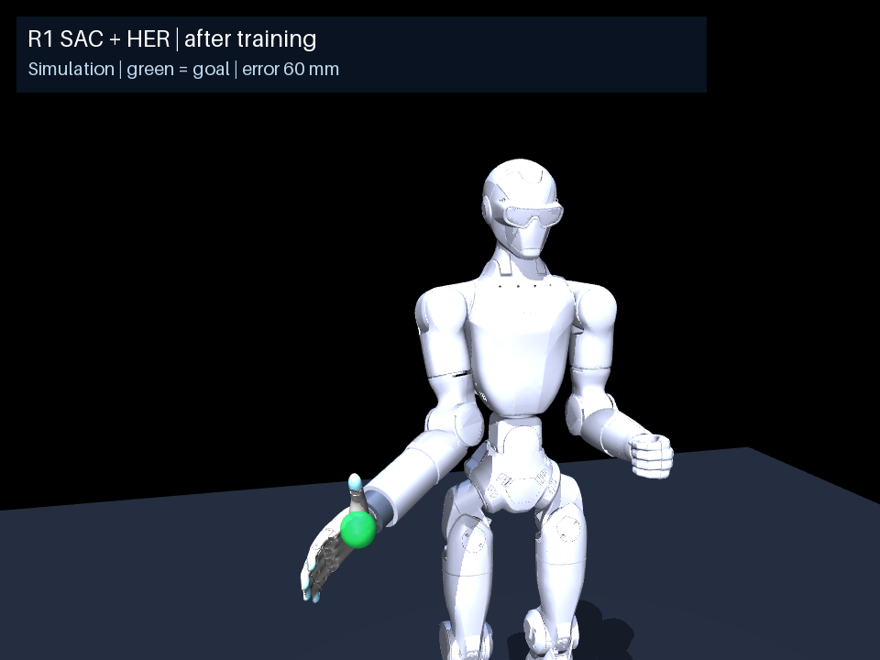
After training: 300,000 steps
68 / 100
successes on the widest test set
The arm reaches and holds near this target, then drifts slightly away.
This clip ends 5.9 cm away. It meets the hold requirement earlier.
5
Notes:
The final checkpoint has 300,000 transitions and 73,750 SAC optimizer updates. This clip completes a consecutive ten-control-step dwell within 4 cm, with no detected collision, but does not stay there to episode end. Its final position error is 5.94 cm. Success and final position error are different measurements. The widest final test has 68/100 successes and seven detected collision episodes.
Sources
/Users/cesarpascal/Documents/Training/real_r1_arm_policy/rl_reach/runs/cpu_dense_seed1011/after_training_seed800000_metrics.json
/Users/cesarpascal/Documents/Training/real_r1_arm_policy/rl_reach/runs/cpu_dense_seed1011/after_training_seed800000_joints.csv
/Users/cesarpascal/Documents/Training/real_r1_arm_policy/rl_reach/runs/cpu_dense_seed1011/report.json

Slide 6
Results on 100 matched test targets
Metric | Before | After
Reach and hold success | 0% | 68%
Mean final position error | 32.5 cm | 4.9 cm
Arm/torso collision episodes | 0% | 7%
Success means staying within 4 cm for 0.5 seconds during the episode.
6
Notes:
Matched seeds 900000–900099, goal configuration spread 1.00 radian about home. Both policies use deterministic evaluation. Success requires ten consecutive 20 Hz control frames inside 4 cm at any point, and no detected collision. The seven detected arm/torso collisions terminate their episodes. Mean final error includes all trials, including early collision terminations. We report one training seed, not an aggregate over multiple independent training runs. The 96% success on the last 0.80-radian curriculum evaluation uses a different easier target distribution and 50 episodes, so it must not replace the 68% held-out widest-spread result.
Sources
/Users/cesarpascal/Documents/Training/real_r1_arm_policy/rl_reach/runs/cpu_dense_seed1011/baseline_test.json
/Users/cesarpascal/Documents/Training/real_r1_arm_policy/rl_reach/runs/cpu_dense_seed1011/report.json

Slide 7
Wider reaching needs more work
7 of 100 test episodes had arm/torso collisions.
The next training stage should reduce collisions and keep the arm near the target for longer.
Then add wrist orientation and return-to-rest goals before training grasping.
7
Notes:
The current model fixes pelvis, other arm, legs and fingers. Its hand mounting is inherited from an approximate simulator. The collision detector checks arm/hand against torso/pelvis and does not certify all self-collision pairs. Joint command limits and per-video model-limit audits do not establish hardware safety. Before manipulation, improve collision behavior, sustained holding, orientation and return-to-rest. No physical robot commands appear in this experiment.
Sources
/Users/cesarpascal/Documents/Training/real_r1_arm_policy/rl_reach/README.md

Slide 8
References
[1]
T. Haarnoja, A. Zhou, P. Abbeel, and S. Levine, “Soft actor-critic: Off-policy maximum entropy deep reinforcement learning with a stochastic actor,” in Proc. 35th Int. Conf. Mach. Learn., vol. 80, 2018, pp. 1861–1870.
[2]
M. Andrychowicz et al., “Hindsight experience replay,” in Advances in Neural Information Processing Systems, vol. 30, 2017.
[3]
Stable-Baselines3, “Soft actor critic (SAC),” Stable-Baselines3 Documentation. Accessed: Oct. 11, 2026. [Online]. Available: https://stable-baselines3.readthedocs.io/en/master/modules/sac.html
[4]
Stable-Baselines3, “HER,” Stable-Baselines3 Documentation. Accessed: Oct. 11, 2026. [Online]. Available: https://stable-baselines3.readthedocs.io/en/master/modules/her.html
[5]
MuJoCo, “Overview,” MuJoCo Documentation. Accessed: Oct. 11, 2026. [Online]. Available: https://mujoco.readthedocs.io/en/stable/overview.html
[6]
“R1 arm reaching: Training, evaluation, and midpoint reproduction records,” unpublished simulation data, Oct. 11, 2026.
8
Notes:
IEEE numbered references. Research papers describe the established learning methods. Reference [6] supplies this R1 experiment’s results and video evidence. The dataset is unpublished and is not a claim from references [1]–[5].
[1] https://proceedings.mlr.press/v80/haarnoja18b.html
[2] https://papers.nips.cc/paper/7090-hindsight-experience-replay
[3] https://stable-baselines3.readthedocs.io/en/master/modules/sac.html
[4] https://stable-baselines3.readthedocs.io/en/master/modules/her.html
[5] https://mujoco.readthedocs.io/en/stable/overview.html
[6] Local experiment records
[6] File locations:
/Users/cesarpascal/Documents/Training/real_r1_arm_policy/rl_reach/runs/cpu_dense_seed1011/report.json
/Users/cesarpascal/Documents/Training/real_r1_arm_policy/rl_reach/runs/cpu_dense_seed1011/baseline_test.json
/Users/cesarpascal/Documents/Training/real_r1_arm_policy/rl_reach/runs/cpu_midpoint_seed1011/reproduction.json

